Slide 1
CSC 3210 Computer Organization and Programming
Lab Work 7
Georgia State University
Spring 2023

Slide 2
Learning Objective
Data Transfer,
Arithmetic instructions with variables

Slide 3
Disclaimer
The process shown in these slides might not work in every single computer due to Operating system version, Microsoft Visual Studio versions and everything.
If you find any unusual error, you can inform the instructor.
Instructor will help you resolve the issue.

Slide 4
Lab Work 7 Instructions
Lab 7(a): Expression evaluation
Lab 7(b) : OFFSET operator
Lab 7(c): PTR operator
Lab 7(d): Checking memory data
Lab 7(e): Type, Length and sizeof operator
Due Date: posted on icollege

Slide 5
Plan early …
You have one week time to submit the lab
Start early
If you have issues
Email TA or instructor
Stop by during office hours
Start working at the last moment is not a good idea.
Appendix shows how to create a new project.

Slide 6
Implementing Arithmetic Expressions
HLL compilers translate mathematical expressions into assembly language.
You can do it also.
For example: Do not permit Xval, Yval, or Zval to be modified
Rval = -Xval + (Yval – Zval)
.code
mov eax,Xval
neg eax ; EAX = -26
mov ebx,Yval
sub ebx,Zval ; EBX = -10
add eax,ebx
mov Rval,eax ; -36
.data
Rval SDWORD ?
Xval SDWORD 26
Yval SDWORD 30
Zval SDWORD 40

Slide 7
Implementing Arithmetic Expressions
Translate the following expression into assembly language.
Do not permit Xval, Yval, or Zval to be modified:
Rval = Xval - (-Yval + Zval)
Previous Example:
Rval = -Xval + (Yval – Zval)
Assume that all values are signed doublewords.
mov ebx,Yval
neg ebx
add ebx,Zval
mov eax,Xval
sub eax,ebx
mov Rval,eax
.data
Rval SDWORD ?
Xval SDWORD 26
Yval SDWORD 30
Zval SDWORD 40

Slide 8
Lab 7(a) Expression evaluation
Submission

Slide 9
Submission Instruction
Create a new application to run the following program.
The data segment is provided:
.data
Val1 SWORD 23
Val2 SWORD -35
Val3 SDWORD 4
Evaluate the following expression :
EBX = (-Val3 - val2) + (val1*2)
You can only use Mov, Movsz, Movzx, Add, Sub instructions.
Build and run the program using the debugger
Examine the content of the registers

Slide 10
Submission Instruction
For each lab (7b to 7d) do the following:
Debug through each line of code.
Execute the instruction
Take a screenshot of the code and register window
Record the line number, instruction, Register values in the answer sheet.
Also add the screenshot
Then explain the register or memory contents.

Slide 11
Lab 7(b) OFFSET operator
Submission

Slide 12
OFFSET & PTR Operator
Write and run a program to find the values of each destination operand:
.data
myBytes BYTE 10h,20h,30h,40h
myWords WORD 8Ah,3Bh,72h,44h,66h
myDoubles DWORD 1,2,3,4,5
.code
mov esi, OFFSET myBytes
mov ax, [esi] ; a. AX =
mov eax, DWORD PTR myWords ; b. EAX =
Mov esi, OFFSET myWords
mov ax, [esi+2] ; c. AX =
mov ax, [esi+6] ; d. AX =
mov ax, [esi-4] ; e. AX =

Slide 13
Lab 7(c) PTR operator
Submission

Slide 14
PTR Operator
Write and run a program to find the values of each destination operand:
.data
varB BYTE 65h,31h,02h,05h
varW WORD 6543h,1202h
varD DWORD 12345678h
.code
mov ax, WORD PTR [varB+2] ; a.
mov bl, BYTE PTR varD ; b.
mov bl, BYTE PTR [varW+2] ; c.
mov ax, WORD PTR [varD+2] ; d.
mov eax, DWORD PTR varW ; e.

Slide 15
Lab 7(d) Checking Memory Data
Submission

Slide 16
Checking Memory Data
Write and run a program to find the values of a memory location and a register:
.data
dVal DWORD ?
.code
mov dVal,12345678h
mov ax,WORD PTR dVal+2
add ax,3
mov WORD PTR dVal,ax ; dVal=
mov eax,dVal ;EAX=
See the next slides to find how data in memory are viewed .

Slide 17
Checking Memory Data
Problem 3: Write and run a program to find the values of a memory location and a register:
.data
dVal DWORD ?
.code
mov dVal,12345678h
mov ax,WORD PTR dVal+2
add ax,3
mov WORD PTR dVal,ax ; dVal=
mov eax,dVal ;EAX=
See the next slides to find how data in memory are viewed .

Slide 18
Checking Memory Data
Use Memory window to verify the values of memory locations.
To activate Memory window, run the debugger, go to debug menu and click on windows, open it, go to Memory then choose Memory1.
When you run your program and step over every line you will see the changed values marked with red color.
You Must be in the Debugging Mode to see the memory or the register window

Slide 19
Checking Memory Data
To activate Memory window,
if you want to see the location of your variable in the memory,
Memory window search box (on the top of the memory window, Address:)
write & follow it with the variable name: example: &myVall.
This will take you to the memory locations of your program (.data section).

Slide 20
Checking Memory Data
To activate Memory window,
You can right-click inside the memory window
You will see Popup menu for the debugger’s memory window
You can choose how you want to group your bytes: by 1,2,4, or by 8
You can also presents data in hexadecimal, signed, or unsigned display

Slide 21
Lab 7(e) Type, Length, and Sizeof
Submission

Slide 22
Type, Length, & Sizeof Operators
Write and run a program to find the values of each destination operand:
.data
myBytes BYTE 10h,20h,30h,40h
myWords WORD 3 DUP(?),2000h
myString BYTE "ABCDE"
.code
mov eax, TYPE myBytes ; a.
mov eax, LENGTHOF myBytes ; b.
mov eax, SIZEOF myBytes ; c.
mov eax, TYPE myWords ; d.
mov eax, LENGTHOF myWords ; e.
mov eax, SIZEOF myWords ; f.
mov eax, SIZEOF myString ; g.

Slide 23
Appendix
Create a Project

Slide 24
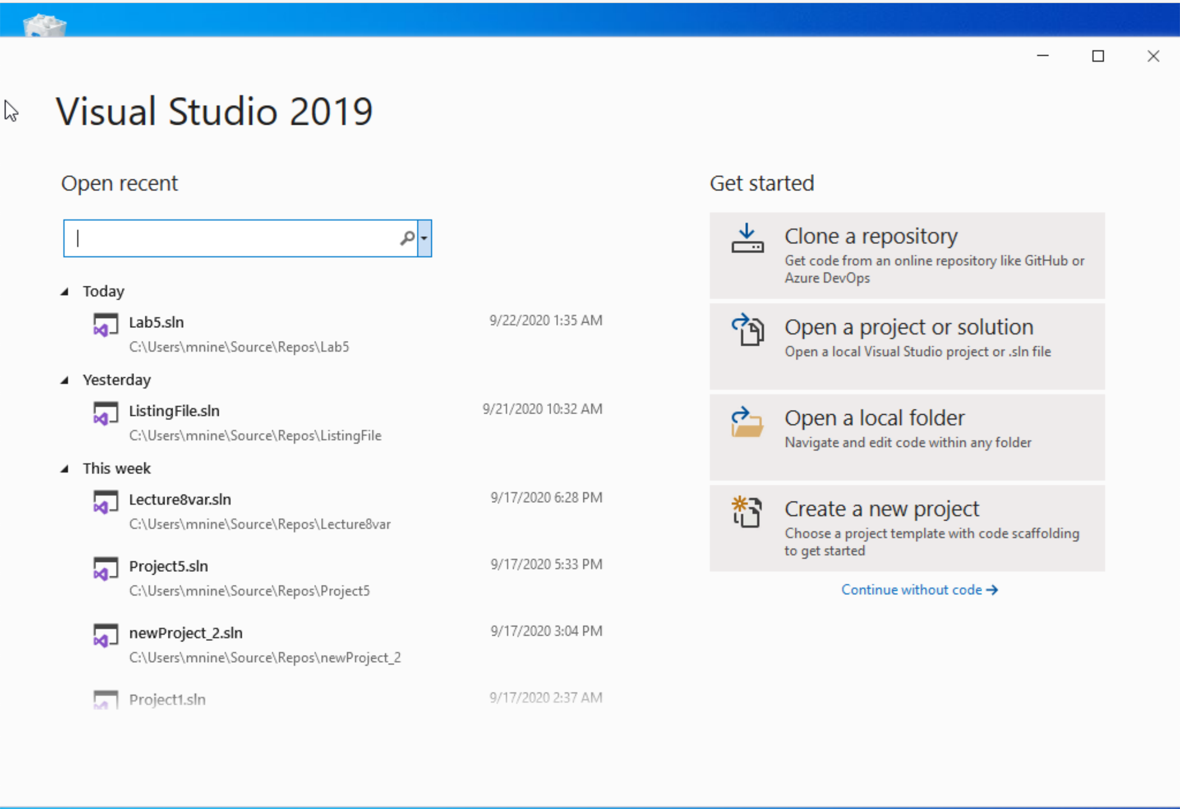


Step 1: Create a project (1)
Start Visual Studio
Click Create a new Project

Slide 25
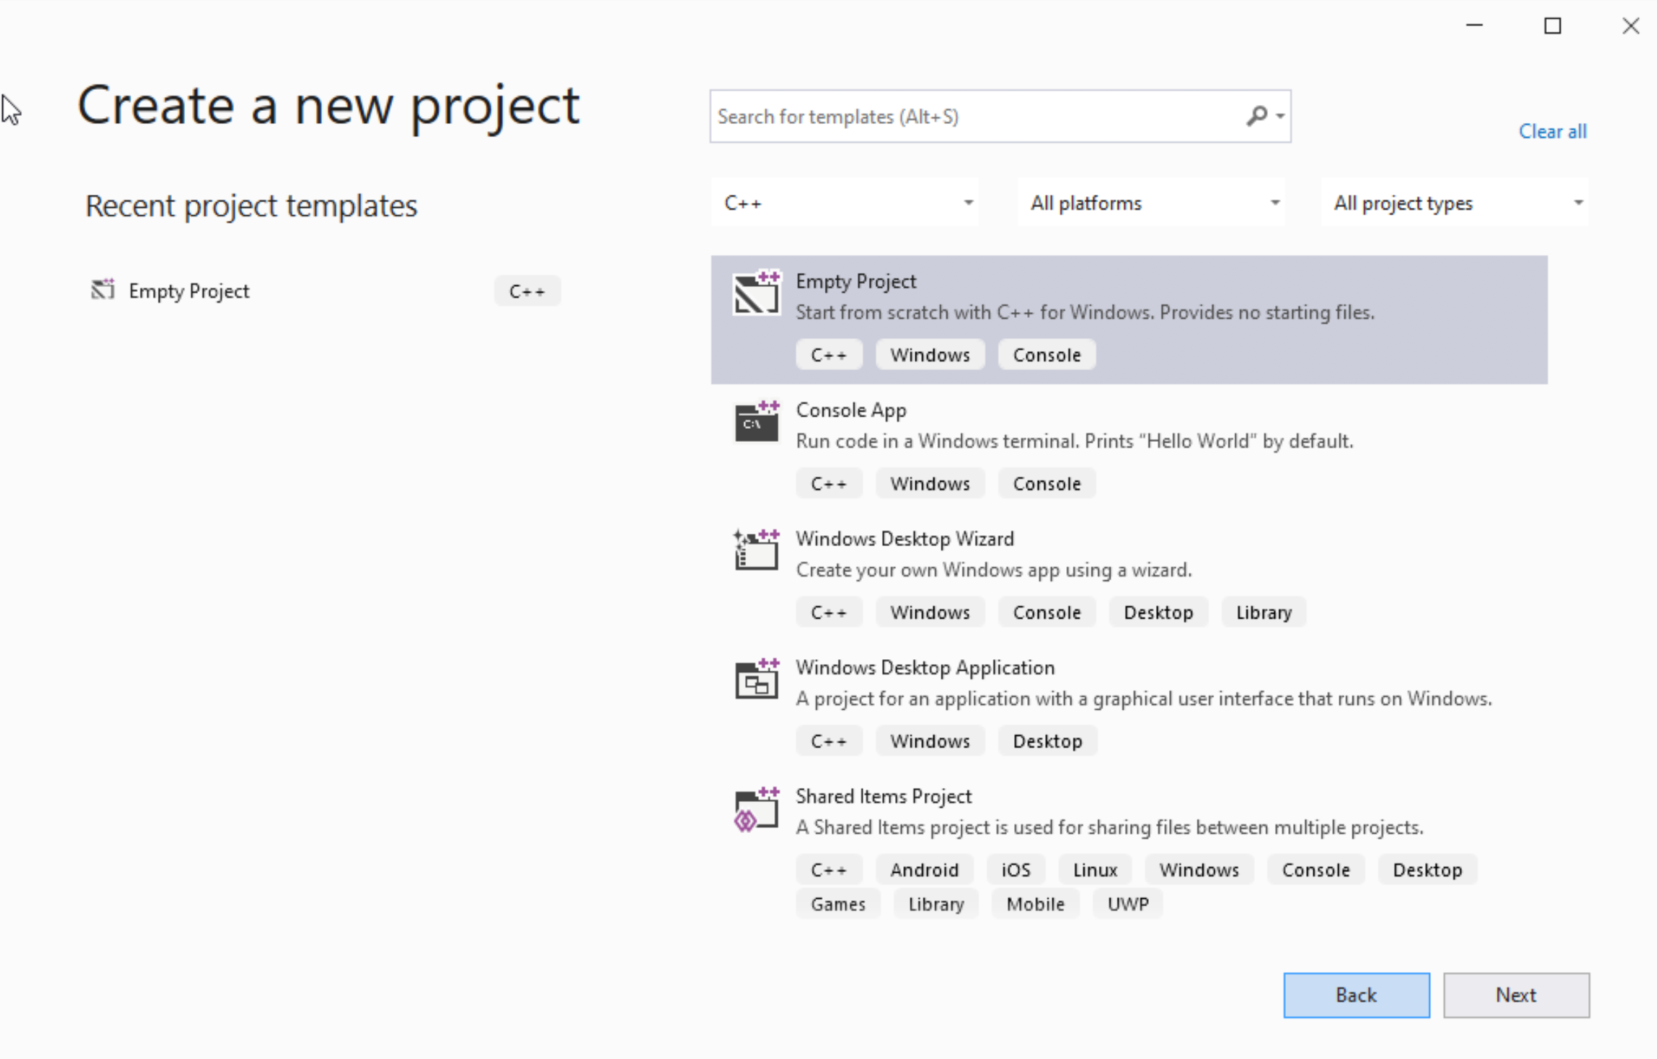




Step 1: Create a project (2)
Select C++ as language
Select Empty Project
Click Next

Slide 26
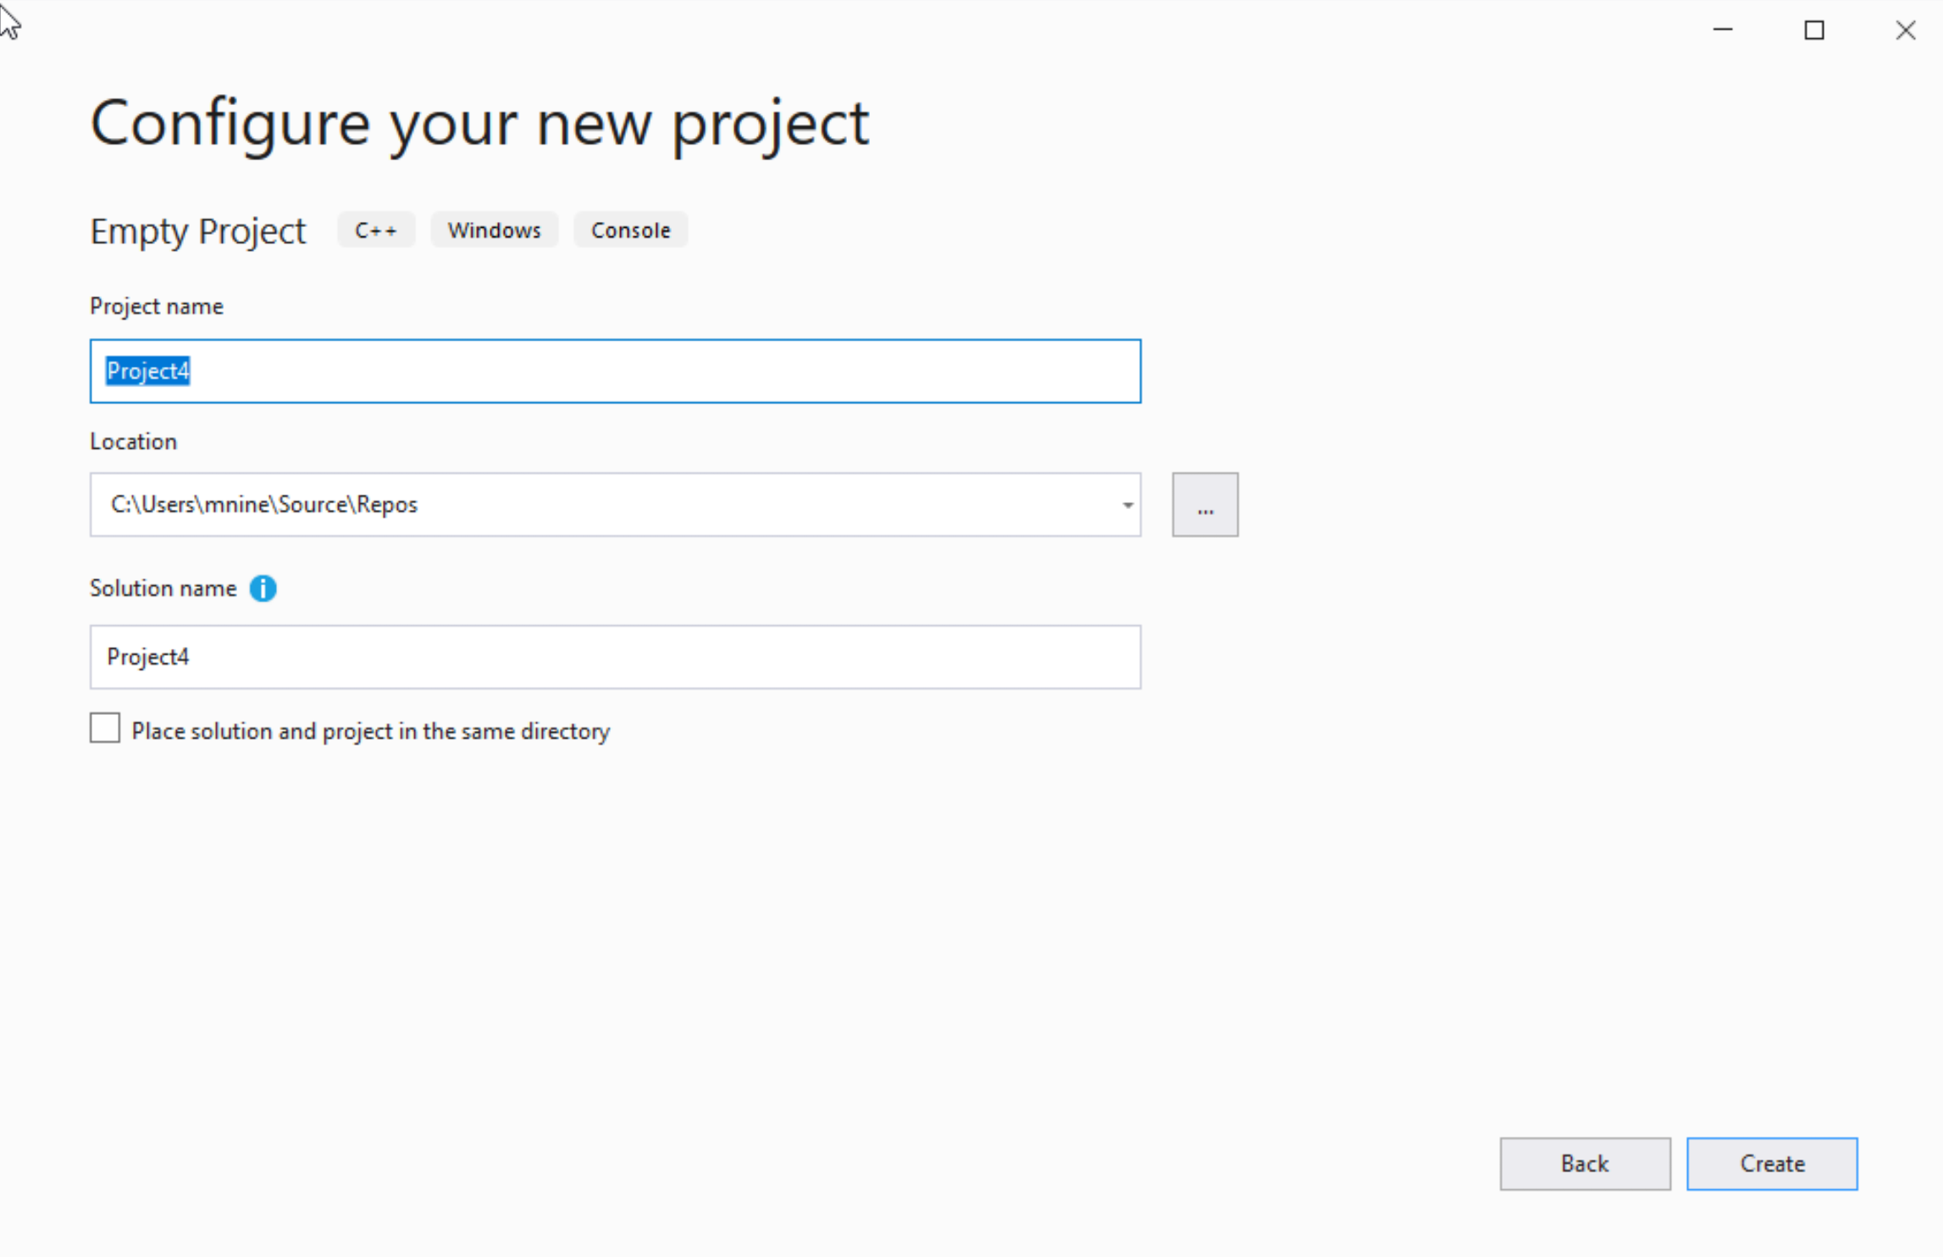

Step 1: Create a project (3)
You can change the project
name as you like
Also, you can change the
project location
Click Next

Slide 27
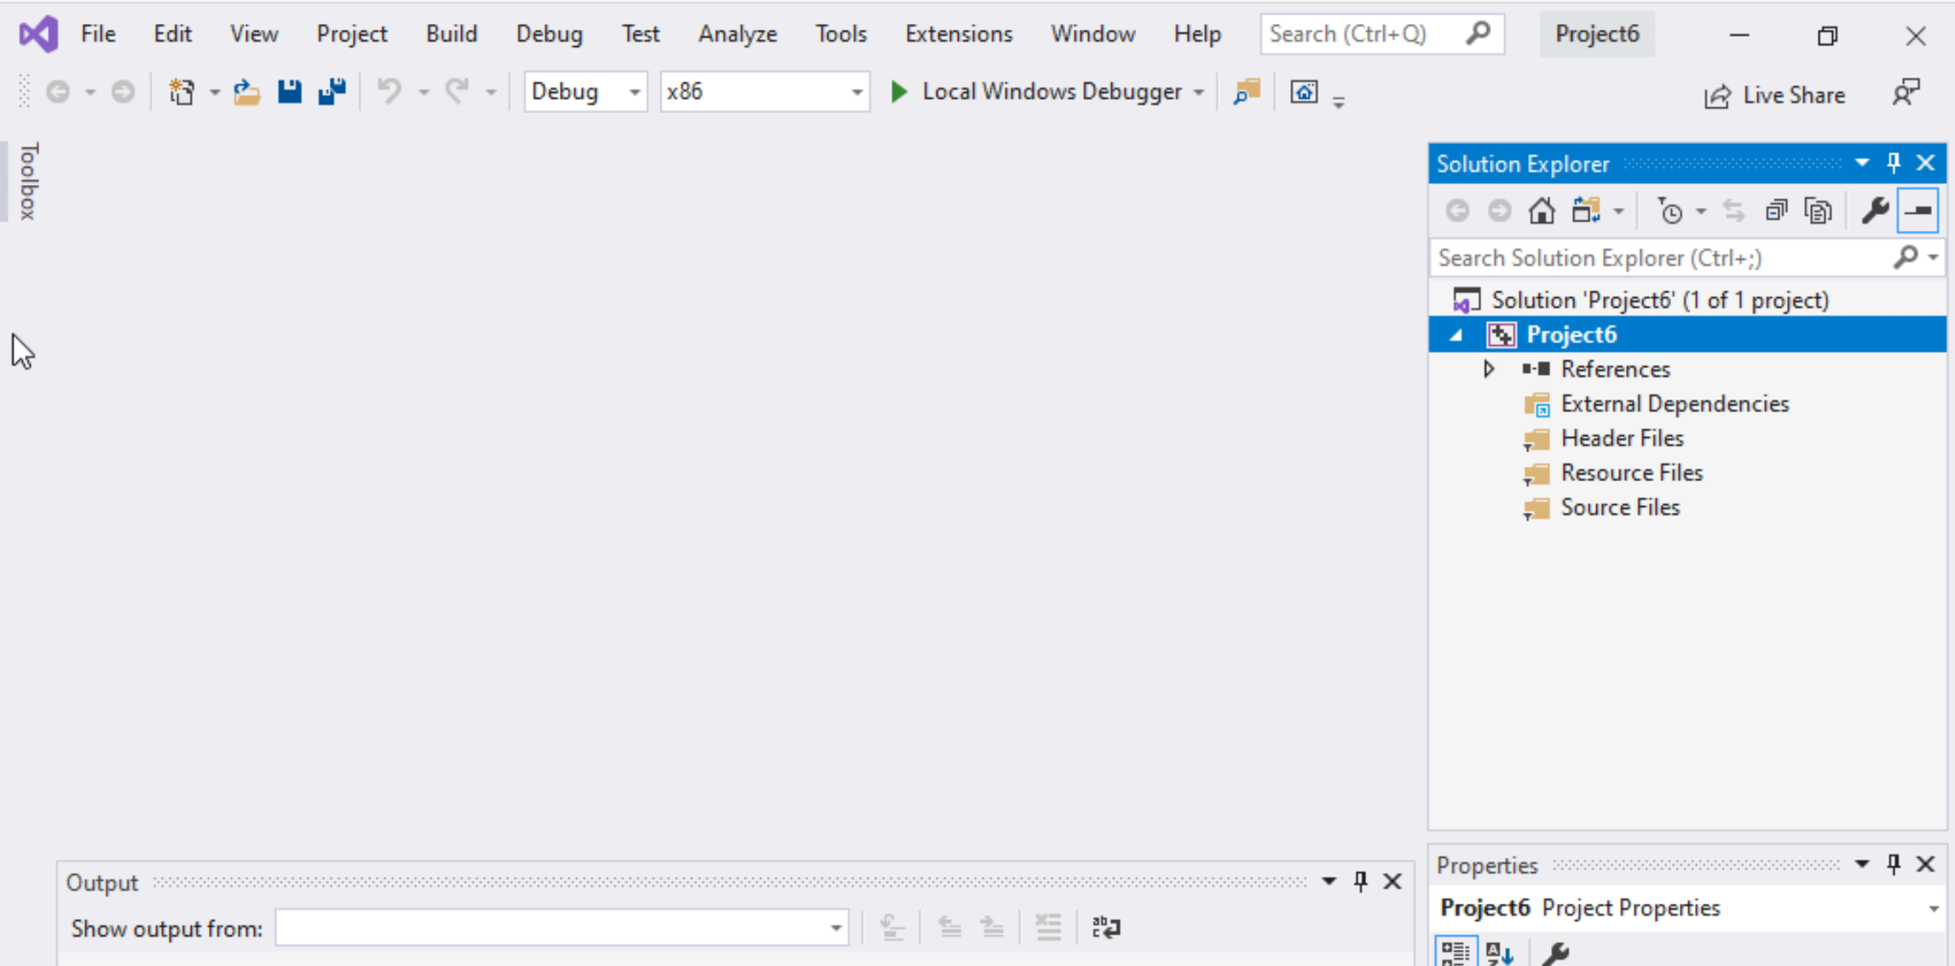
Step 1: Create a project (4)
Delete the
Following folders:
Header files
Resources Files, and
Source Files

Slide 28
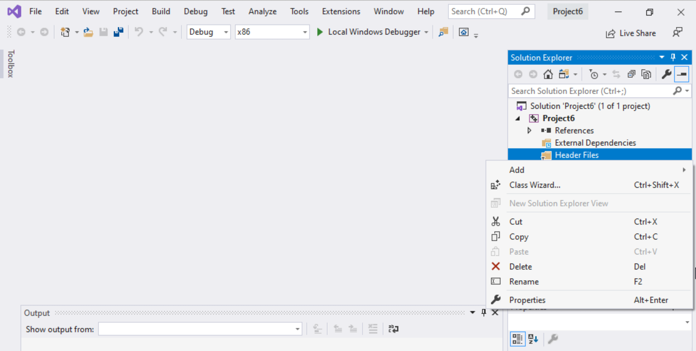
Step 1: Create a project (5)
To delete :
Select the folders
Right click on it
Select delete

Slide 29
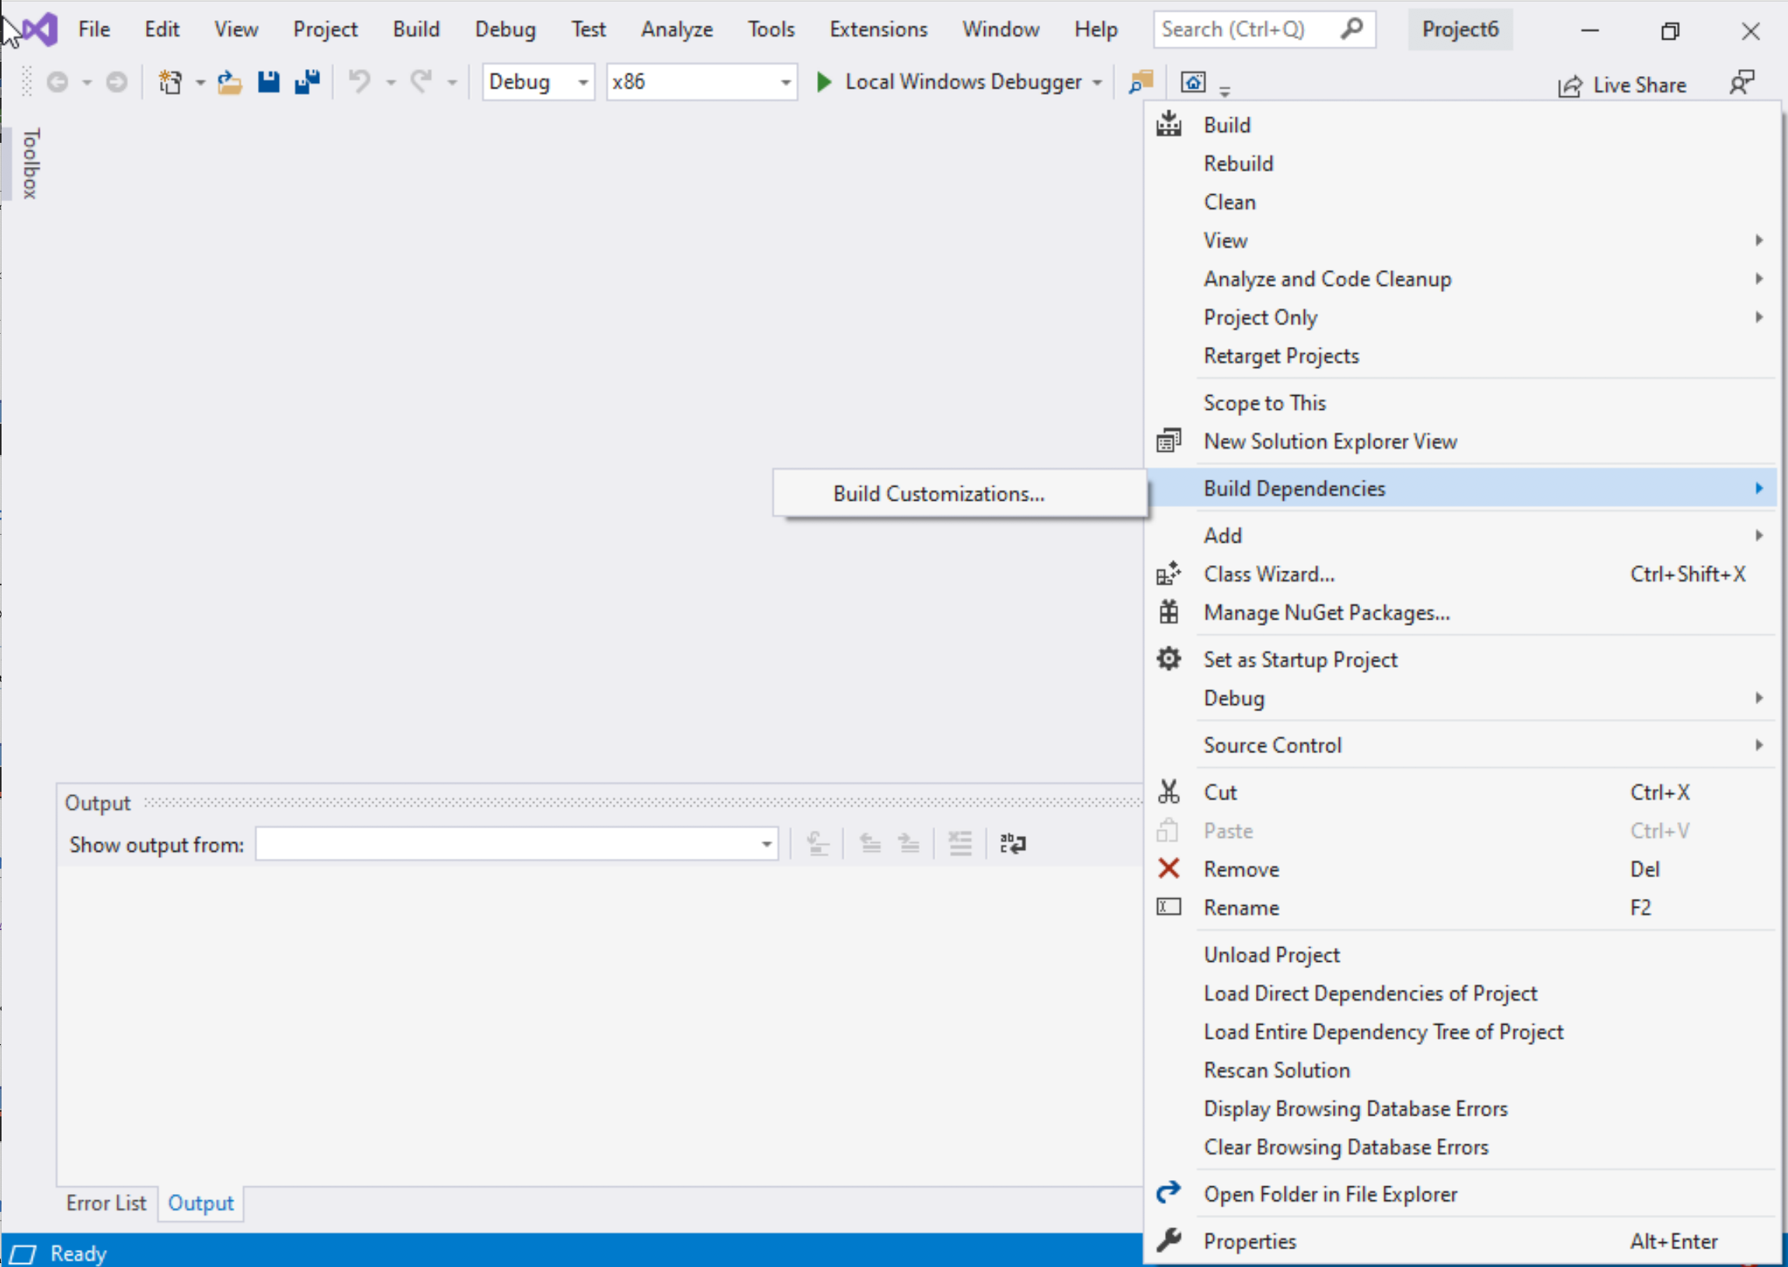
Step 1: Create a project (6)
Select Project Name on solution explorer
Right click on it
Go to Build Dependencies
Click on Build Customizations

Slide 30
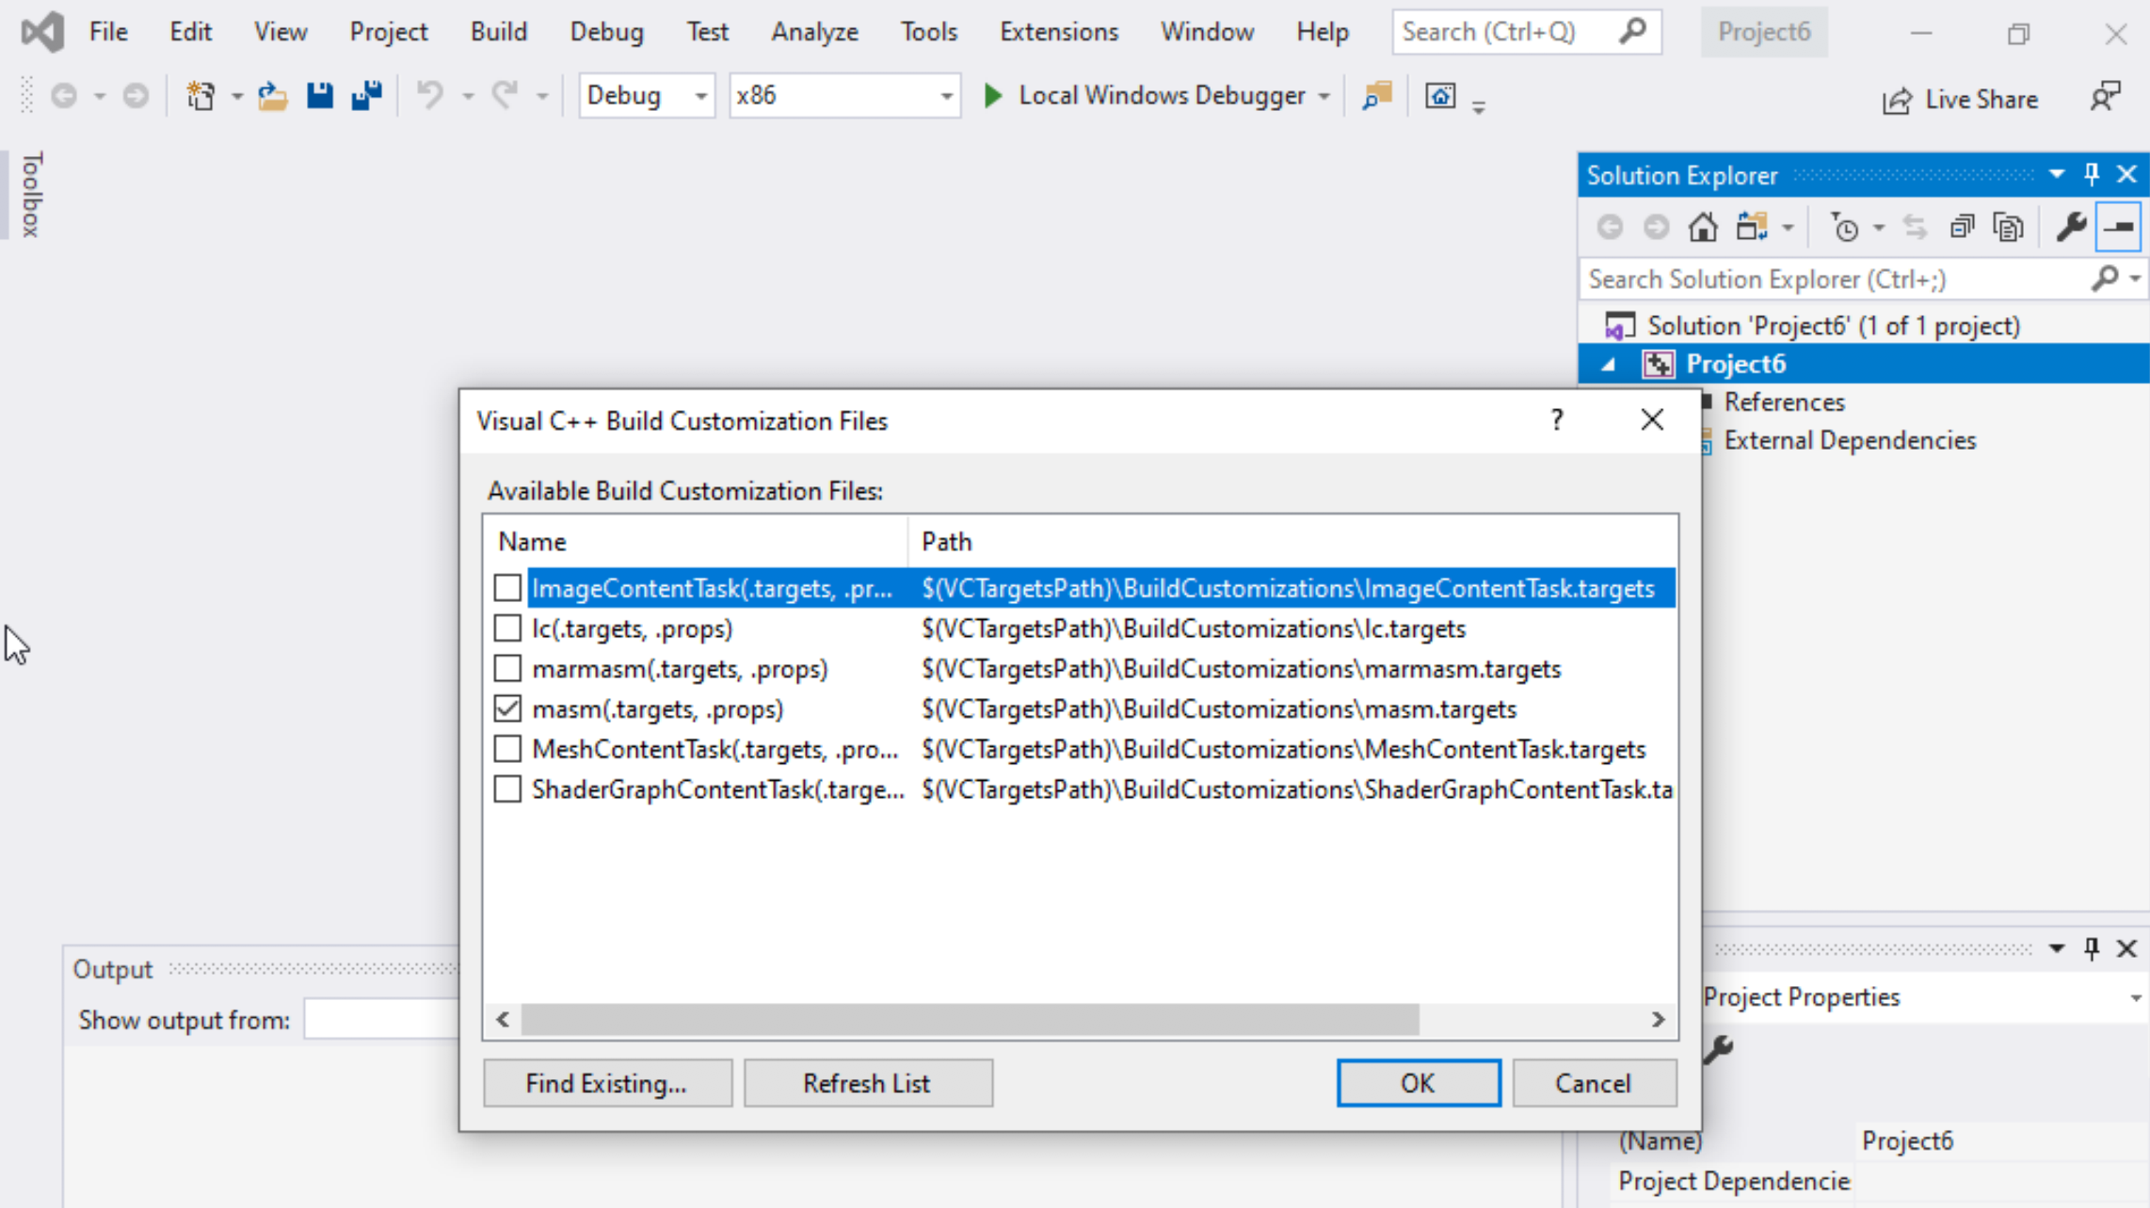
Step 1: Create a project (7)
Select masm(.target, .props)
Click ok

Slide 31
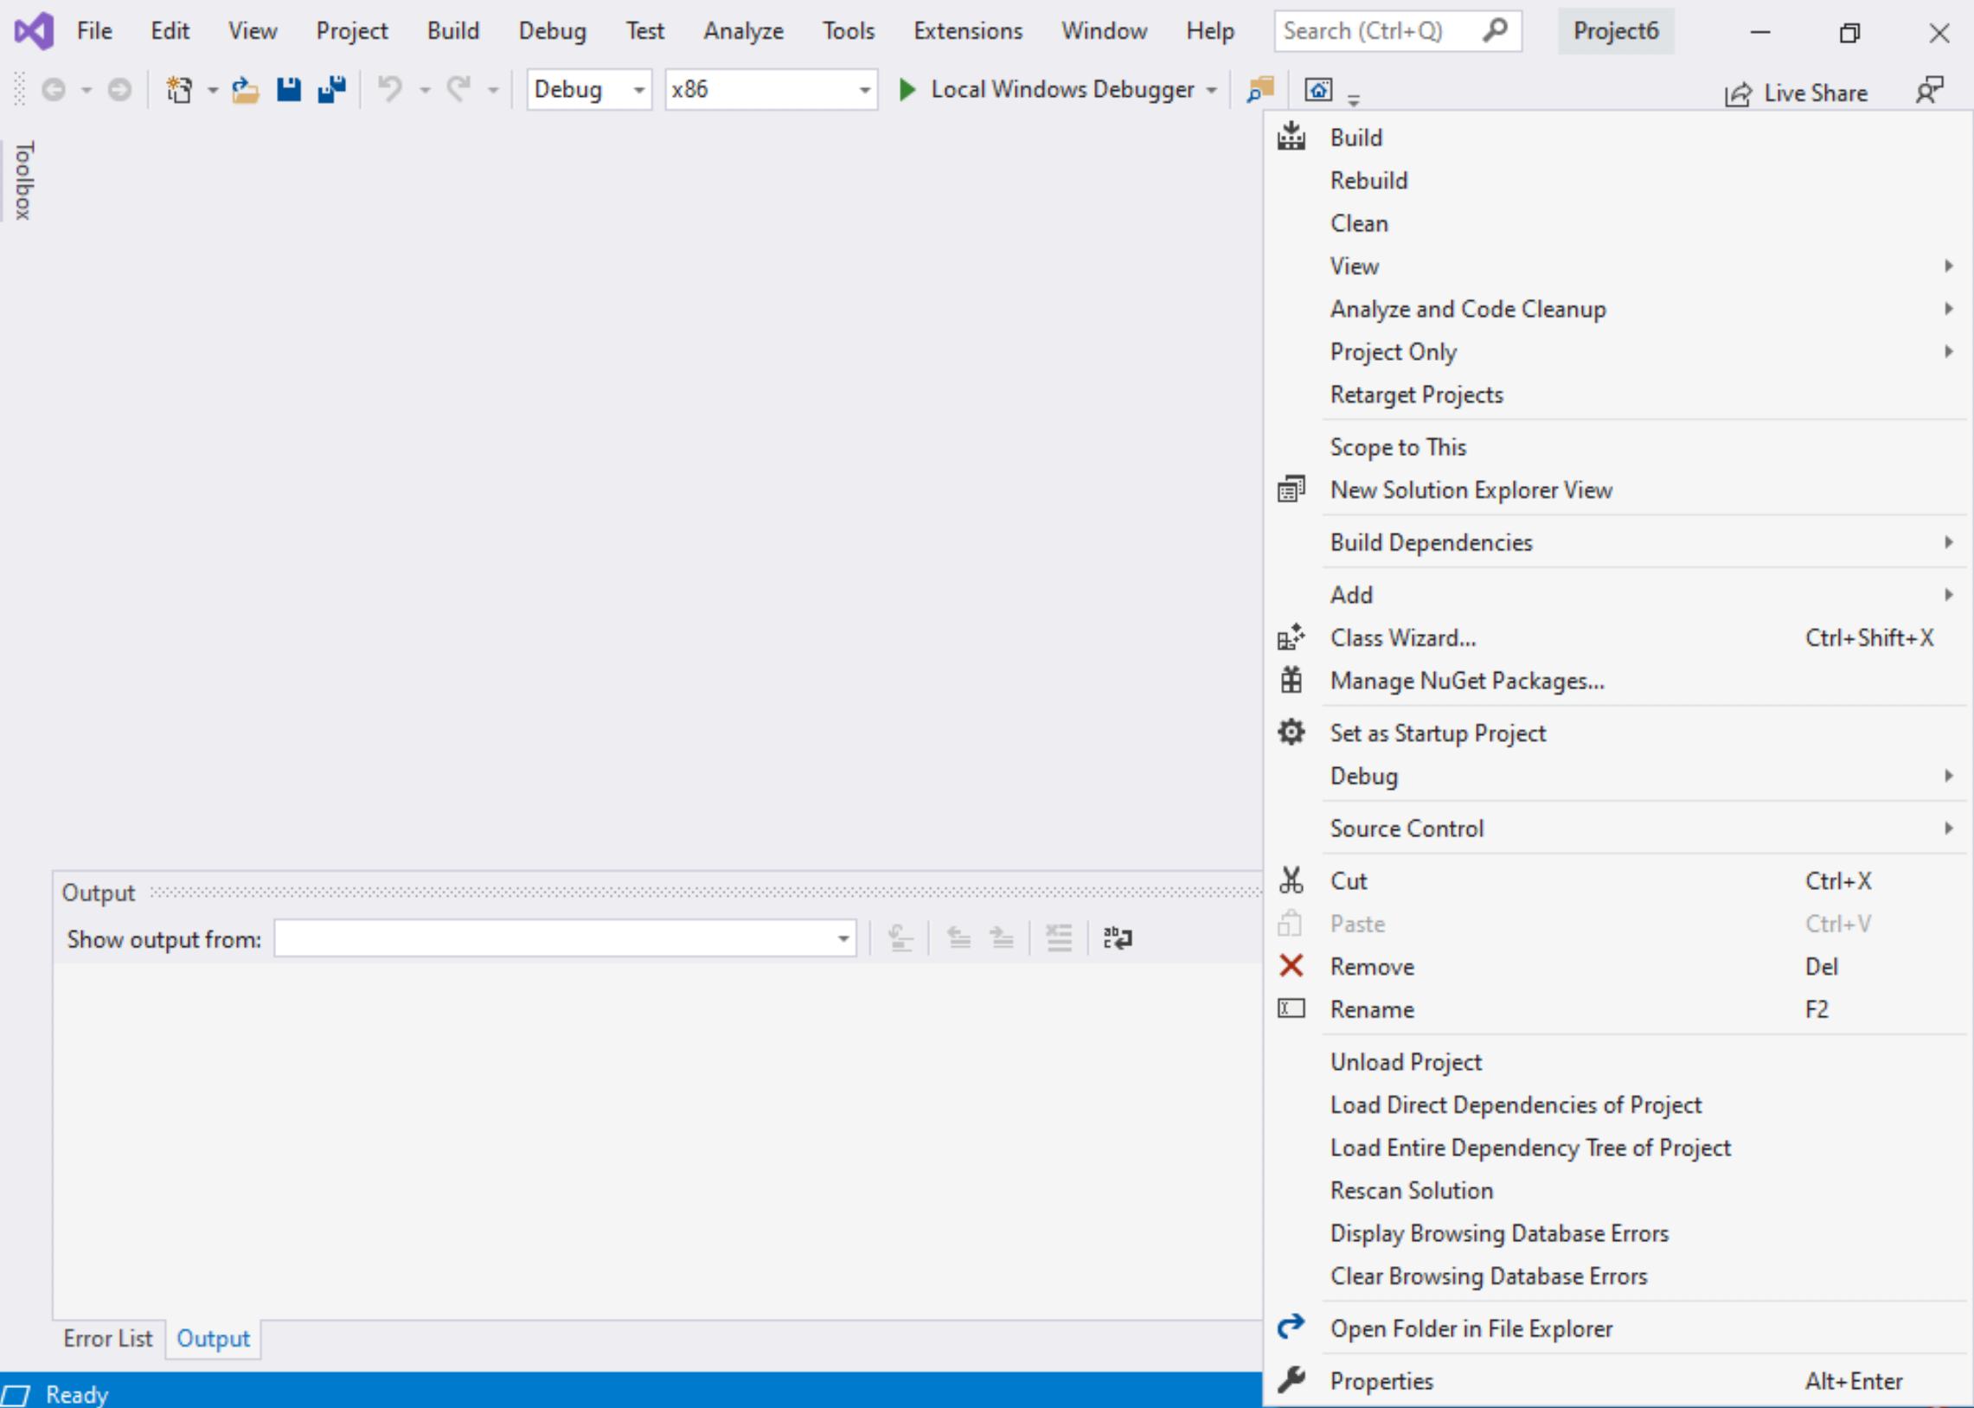
Step 1: Create a project (8)
Right click on the Project name in the solution explorer
Click properties

Slide 32
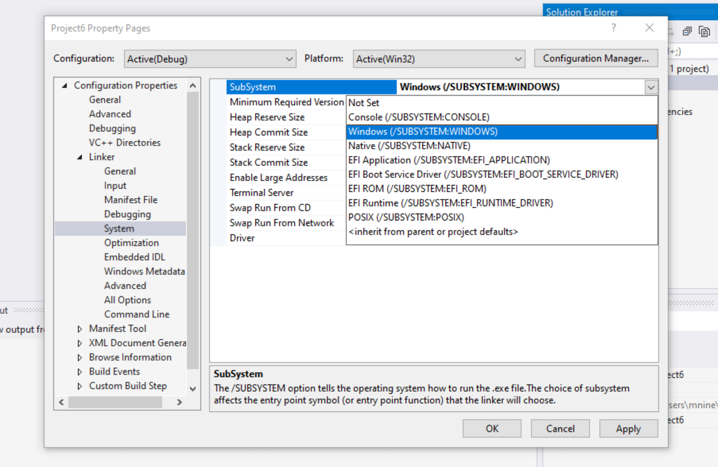

Step 1: Create a project (9)
Expand the ‘Linker’
Select ’System’
Select Windows(/SUBSYSTEM:WINDOWS)
Click OK

Slide 33
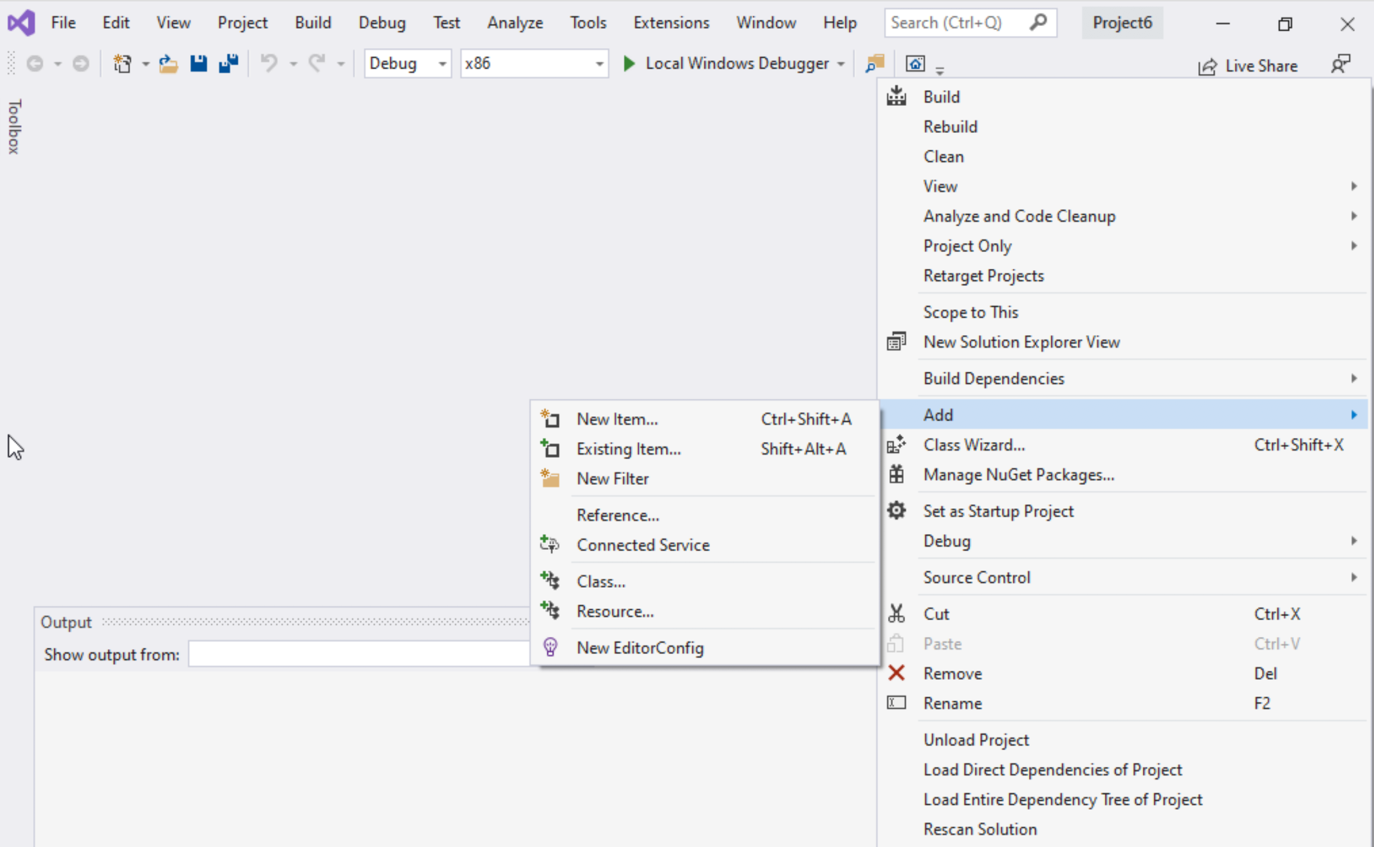
Step 1: Create a project (10)
Select Project name on solution explorer
Right click on it
Expand Add
Choose New Item

Slide 34
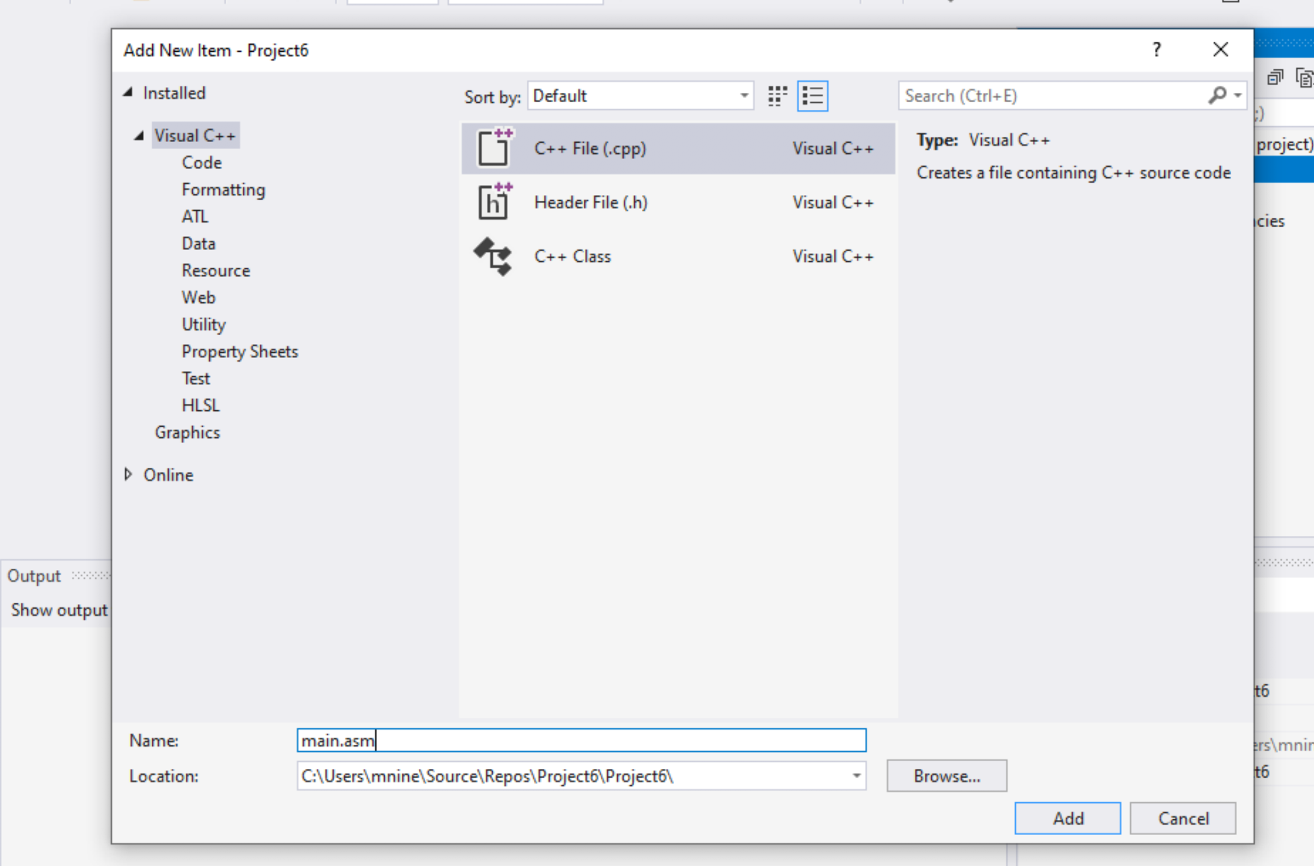


Step 1: Create a project (11)
Select C++ File(.cpp)
Name: main.asm
Click Add

Slide 35
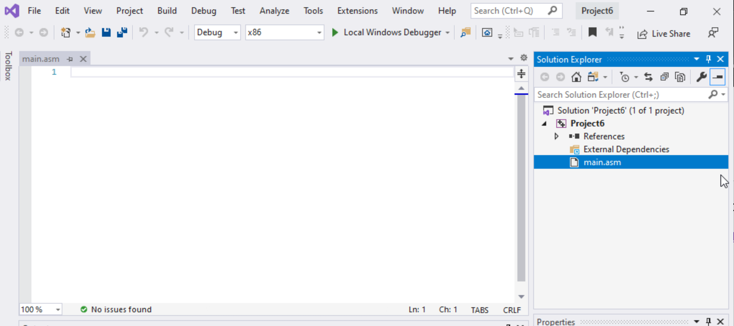

Step 1: Create a project (12)
Select main.asm
Add your code
In the main.asm File.

